Slide 1
Introduction to Statistical Mechanics
POTENTIAL OF MEAN FORCE
October, 2022

Slide 2
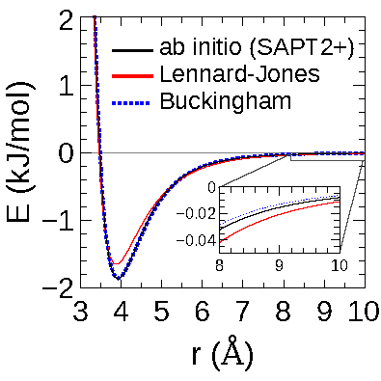
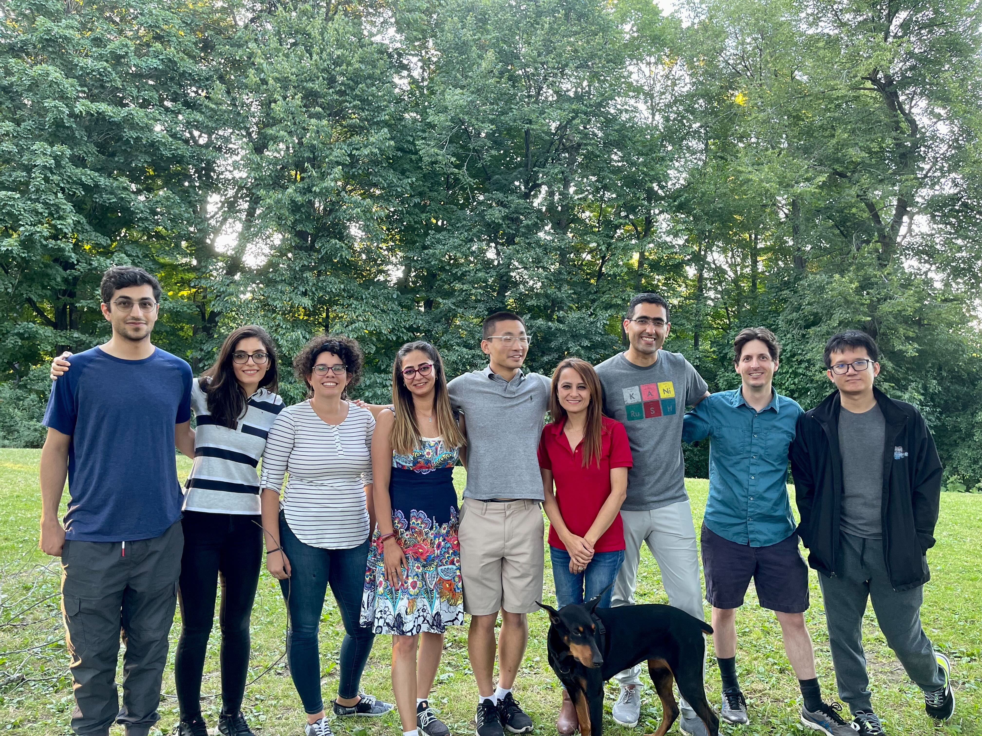
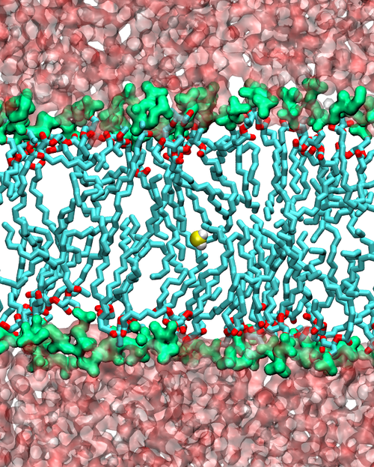
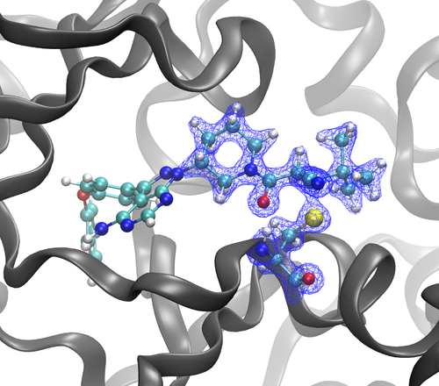
Introduction to Our Group
RowleyGroup@CarletonU
rowleygroup.net
@zeldery2
<number>

Slide 3
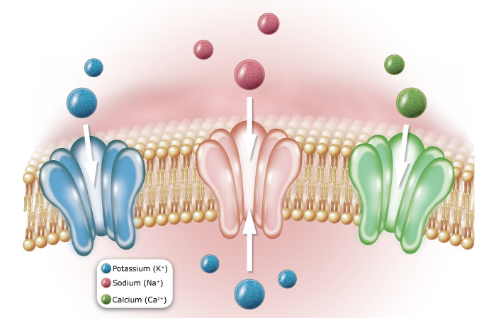
Ion Channel
A protein structure on the membrane
Allow ion going through selectively
<number>

Slide 4
Energy Profile
<number>

Slide 5
Direct Approach - Scanning
Ignore the flexibility of the protein
Ignore the decrease in entropy
<number>

Slide 6
More Appropriate Approach
$F=\frac{−dU}{dx}$
Force
Energy
$F=\frac{−dU}{dx}$
The coordinate(s)
$\left\langle F\right\rangle =\frac{\int{F}e^{\frac{−U\left(x\right)}{kT}}dx}{\int{e^{\frac{−U\left(x\right)}{kT}}}dx}$
The ensemble
Summary: run simulation, get the force, get its average on the desired axis, integral for the energy
<number>

Slide 7
Alternative Approach
$P∼e^{\frac{−U}{kT}}$
Summary: Run simulation, collect the coordinate, build the histogram, reconstruct energy
<number>

Slide 8
It’s the same thing.
The first approach energy is related to free energy
The first approach is equivalent with the second approach
<number>

Slide 9
Mathematical Proof
$F=\frac{−dU}{dx}$
$\left\langle F\right\rangle =\frac{\int{\left(\frac{−dU\left(x\right)}{dz}\right)}e^{\frac{−U\left(x\right)}{kT}}dx}{\int{e^{\frac{−U\left(x\right)}{kT}}}dx}$
$\left\langle F\right\rangle =\frac{\int{F}e^{\frac{−U\left(x\right)}{kT}}dx}{\int{e^{\frac{−U\left(x\right)}{kT}}}dx}$
$\frac{d}{dz}\left(e^{\frac{−U\left(x\right)}{kT}}\right)=e^{\frac{−U\left(x\right)}{kT}}\frac{d}{dz}\left(\frac{−U\left(x\right)}{kT}\right)$
$\left\langle F\right\rangle =\frac{kT\int{\frac{d}{dz}\left(\frac{−dU\left(x\right)}{kT}\right)e^{\frac{−U\left(x\right)}{kT}}dx}}{\int{e^{\frac{−U\left(x\right)}{kT}}}dx}$
$\left\langle F\right\rangle =\frac{kT\int{\frac{d}{dz}\left(e^{\frac{−U\left(x\right)}{kT}}\right)}dx}{\int{e^{\frac{−U\left(x\right)}{kT}}}dx}$
<number>

Slide 10
Mathematical Proof (cont’)
$\left\langle F\right\rangle =\frac{kT\int{\frac{d}{dz}\left(e^{\frac{−U\left(x\right)}{kT}}\right)}dx}{\int{e^{\frac{−U\left(x\right)}{kT}}}dx}$
$\int{\frac{d}{dx}f\left(x,y\right)dxdy}=\frac{d}{dx}\int{f}\left(x,y\right)dxdy$
$\left\langle F\right\rangle =\frac{kT\frac{d}{dz}\int{\left(e^{\frac{−U\left(x\right)}{kT}}\right)}dx}{\int{e^{\frac{−U\left(x\right)}{kT}}}dx}$
$Q=\int{e^{\frac{−U\left(x\right)}{kT}}}dx$
$\left\langle F\right\rangle =\frac{kT\frac{dQ}{dz}}{Q}$
$\frac{dlnf\left(x\right)}{dx}=\frac{1}{f\left(x\right)}\frac{df\left(x\right)}{dx}$
$\left\langle F\right\rangle =kT\frac{dlnQ}{dz}$
<number>

Slide 11
Mathematical Proof (cont’)
$W_{AB}=\int_{a}^{b}{F}ds$
$\left\langle F\right\rangle =kT\frac{dlnQ}{dz}$
$W_{AB}=\int_{a}^{b}{\left\langle F_{z}\right\rangle }dz$
$W_{AB}=\int_{a}^{b}{kT}\frac{dlnQ}{dz}dz$
$W_{AB}=kT\int_{a}^{b}{dlnQ}$
$\int{dx}=x$
$\int{df}\left(x\right)=f\left(x\right)$
$W_{AB}=kTlnQ_{B}−kTlnQ_{A}$
<number>

Slide 12
What all of this means
The “potential” related to the mean force is a state function, that relates to free energy
$A=−kTlnQ$
$W_{AB}=kTlnQ_{B}−kTlnQ_{A}$
$W_{AB}=A_{A}−A_{B}$
The energy can be calculated from the variable distribution in the ensemble
$P\left(s\right)=\frac{\int{δ\left(z−s\right)e^{\frac{−U\left(x\right)}{kT}}}dx}{\int{e^{\frac{−U\left(x\right)}{kT}}}dx}$
$V\left(s\right)=−kTlnP\left(s\right)$
<number>

Slide 13
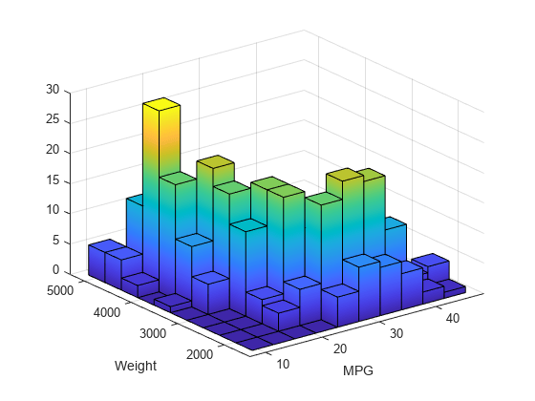
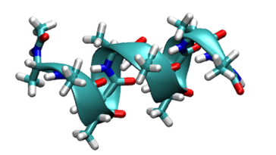
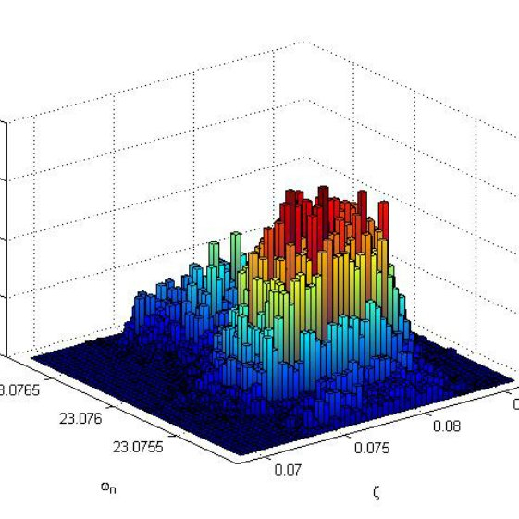
Expansion
Work on non-mechanical / collective variables
Helicity
0.0
1.0
Work on multiple variables
<number>

Slide 14
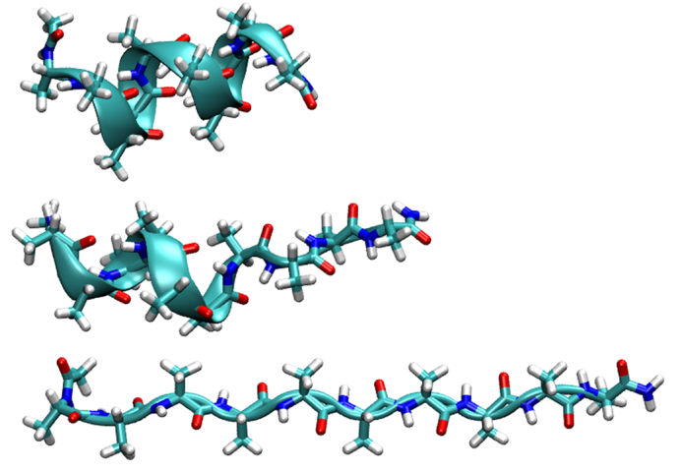
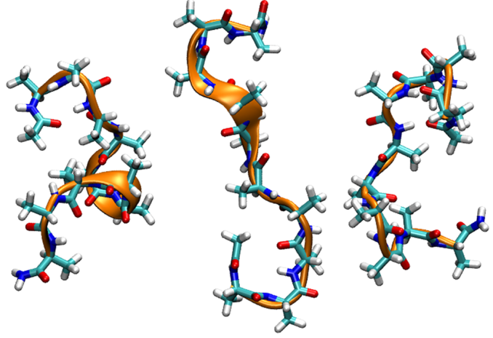
Example: deca-alanine
J. Chem. Theory Comput. 2014, 10, 2836−2844
<number>

Slide 15
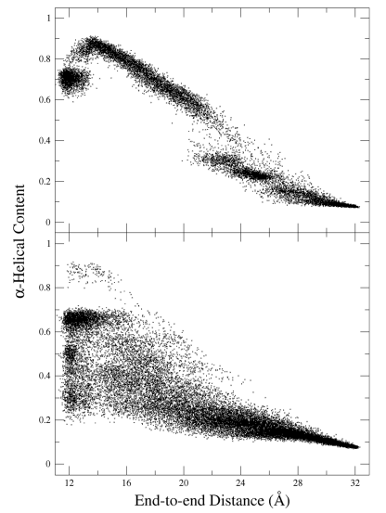
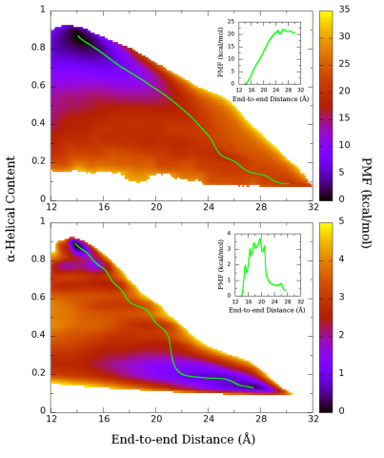
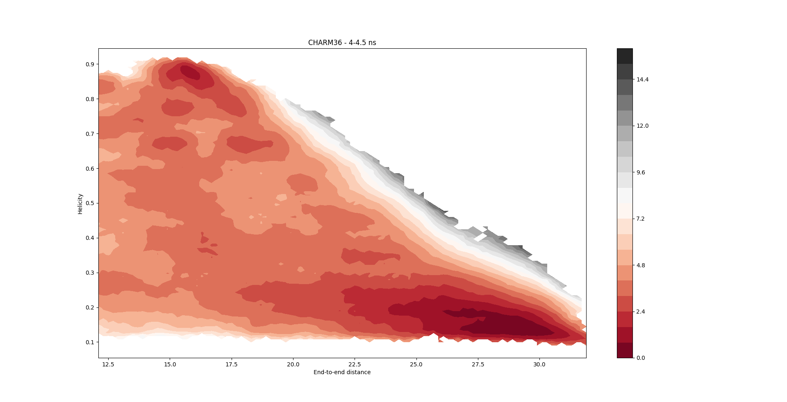
Example: energy profile and reaction path
J. Chem. Theory Comput. 2014, 10, 2836−2844
<number>

Slide 16
Direct Simulation is Slowwwwwww
Ordinary simulation does not need to visit all the states, especially high-energy states
$\left\langle M\right\rangle =\frac{\int{M}e^{\frac{−U\left(x\right)}{kT}}dx}{\int{e^{\frac{−U\left(x\right)}{kT}}}dx}$
Energy unit: kT = 0.6 kcal/mol
Potential of Mean Force need the distributions, even in the high-energy states.
<number>

Slide 17
Free Energy Perturbation
$U\left(x\right)=U_{o}\left(x\right)+w\left(z\right)$
$Q=\int{e^{\frac{−U_{o}\left(x\right)}{kT}}}dx$
$Q=\int{e^{\frac{−U\left(x\right)}{kT}}}dx=e^{\frac{−w\left(z\right)}{kT}}\int{e^{\frac{−U_{o}\left(x\right)}{kT}}}dx$
$\left\langle M\right\rangle =\frac{\int{M}e^{\frac{−U_{o}\left(x\right)}{kT}}dx}{\int{e^{\frac{−U_{o}\left(x\right)}{kT}}}dx}$
$\left\langle M\right\rangle =\frac{\int{M}e^{\frac{−U\left(x\right)}{kT}}dx}{\int{e^{\frac{−U\left(x\right)}{kT}}}dx}=e^{\frac{−w\left(z\right)}{kT}}\frac{\int{M}e^{\frac{−U_{o}\left(x\right)}{kT}}dx}{\int{e^{\frac{−U_{o}\left(x\right)}{kT}}}dx}\frac{\int{}e^{\frac{−U_{o}\left(x\right)}{kT}}dx}{\int{e^{\frac{−U\left(x\right)}{kT}}}dx}$
<number>

Slide 18
Umbrella Sampling
Cannot determine the energy!!
Get the energy in form of harmonic restrain
Run multiple simulation for multiple “windows”
<number>

Slide 19
Weighted Histogram Analysis Method
The method to determine the potential of mean force from umbrella sampling
The method need to compute the distribution while calibrating for the external force effects
Compute iteratively
$P\left(z\right)=\frac{\sum_{i}{n_{i}}\left(z\right)}{\sum_{i}{N_{i}}\left(z\right)e^{\frac{F_{i}−\frac{1}{2}k_{i}\left(z−z_{i}\right)}{kT}}}$
$F_{i}=−kTln\left(\sum_{i}{P}\left(z\right)e^{\frac{−\frac{1}{2}k_{i}{\left(z−z_{i}\right)}^{2}}{kT}}\right)$
Kumar et al. J. Comput. Chem. 1992, 13, 1011; Roux, Comput. Phys. Comm. 1995, 91, 275
<number>

Slide 20
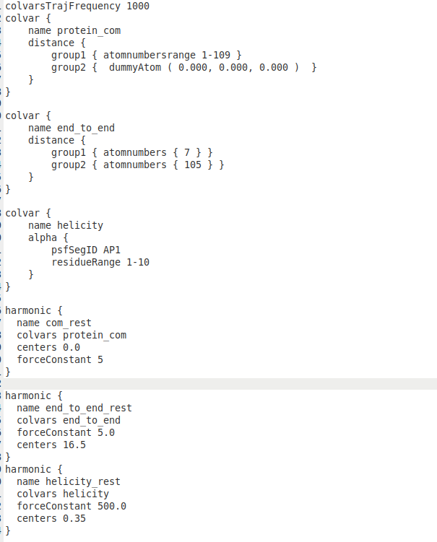
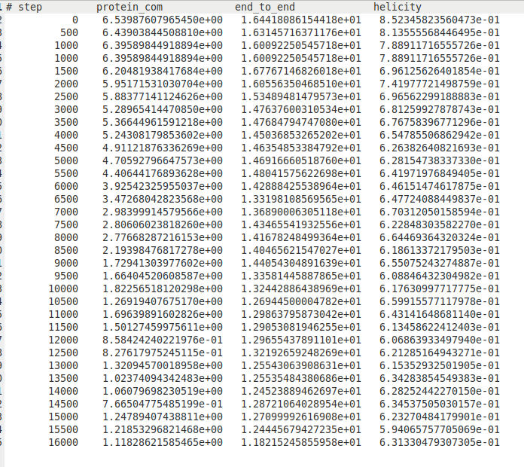
What the files actually look like
<number>

Slide 21
Conclusions
PMF is:
+ a powerful method to get energy profile
+ related to the free energy of the system
+ measured by getting the distribution of values in simulation
+ need enhanced sampling and data analysis to use efficiently.
<number>

Slide 22
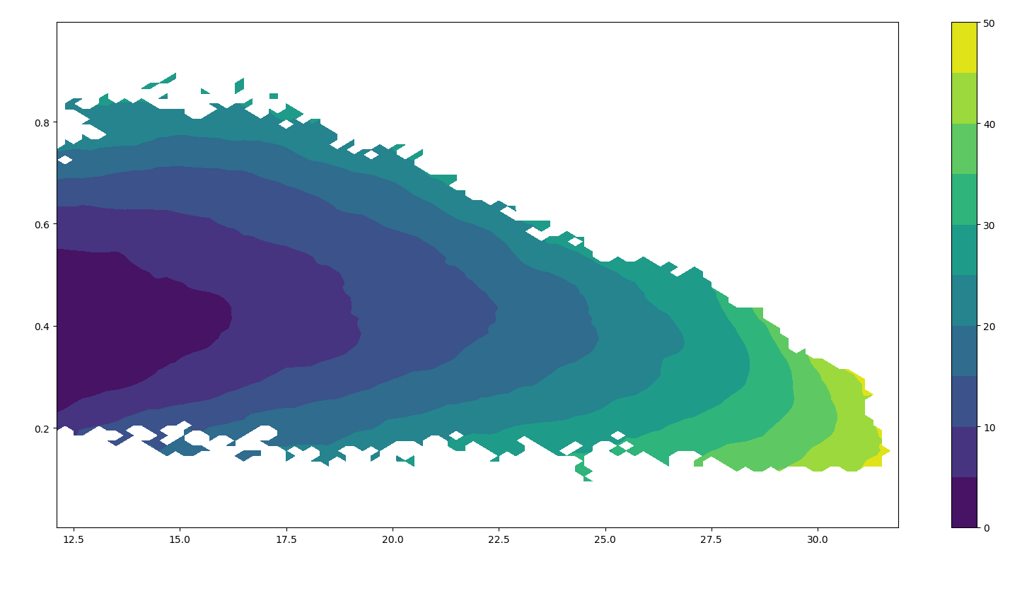
<number>

